Slide 1


Tennessee State University
Banner Finance Self-Service Training
Roar to Success
Budget Status by Account Query

Slide 2

Lesson Objectives
Correctly set up the Budget Status by Account Query.
Interpret a Budget Status by Account query accurately.
Determine when to use the Budget Status by Account query by reviewing examples.

Slide 3
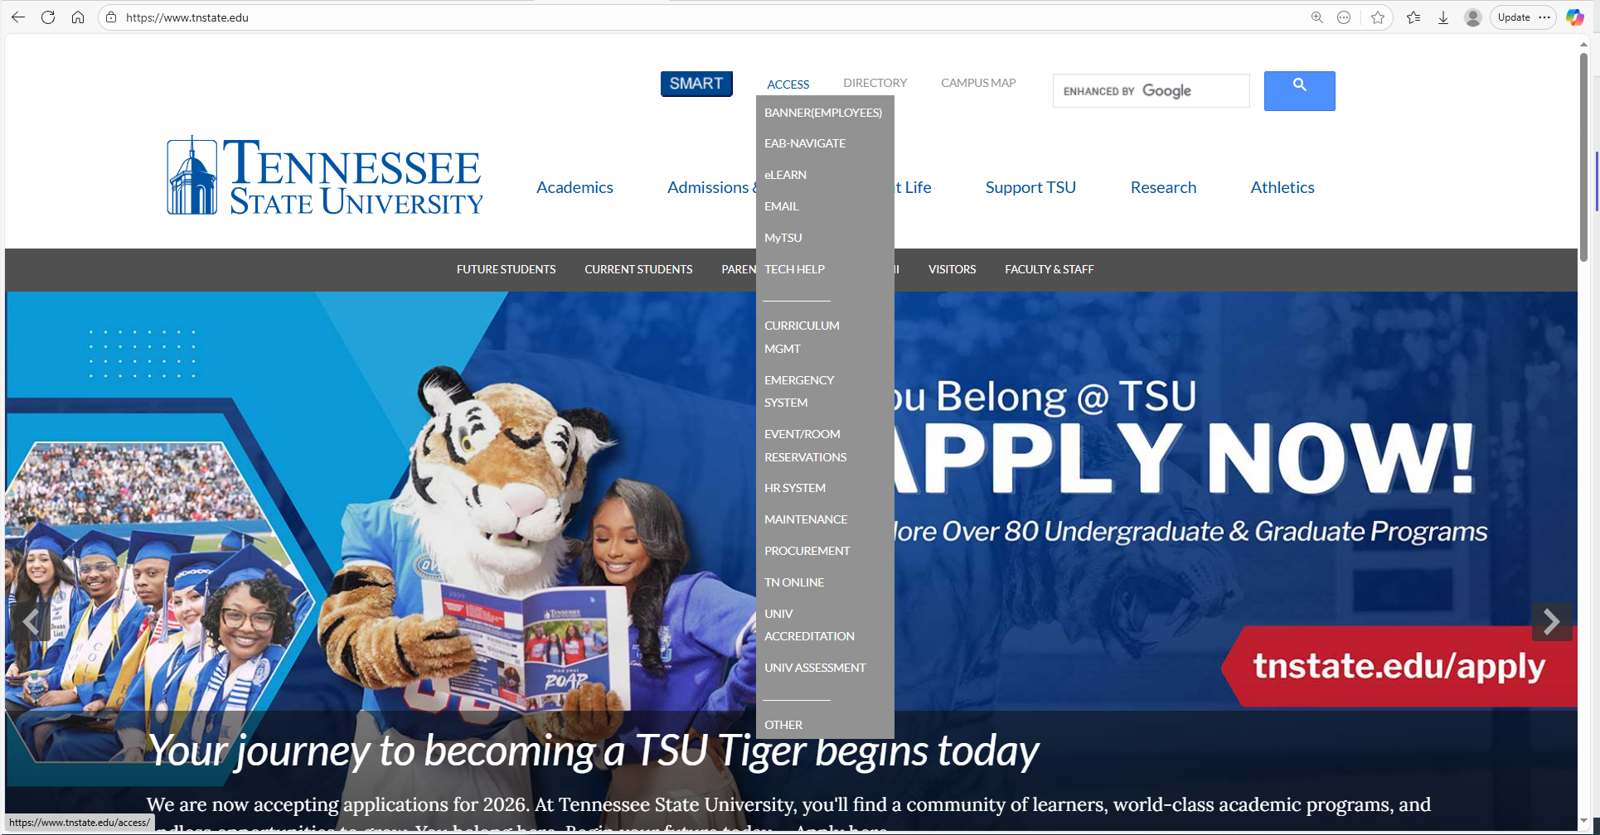
Getting to Self Service Banner
Go to the main TSU website www.tnstate.edu
Then click MyTSU

Slide 4
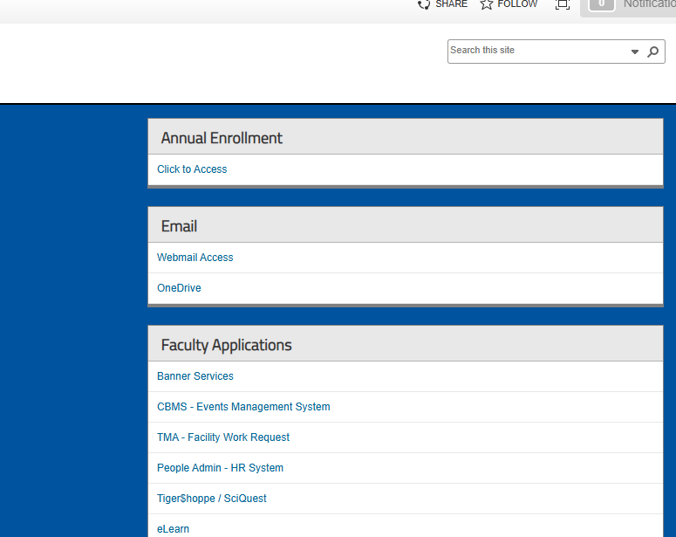
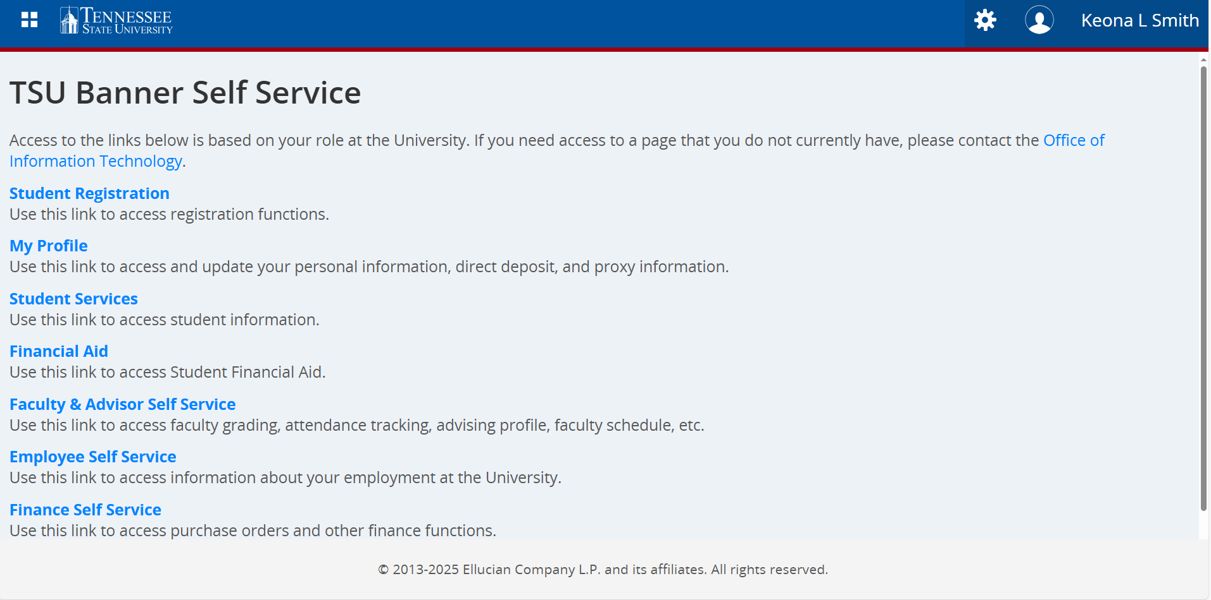
Getting to Self Service Banner
Now
click
Banner
Services
Next Select
Banner Services
Finance Self Service

Slide 5
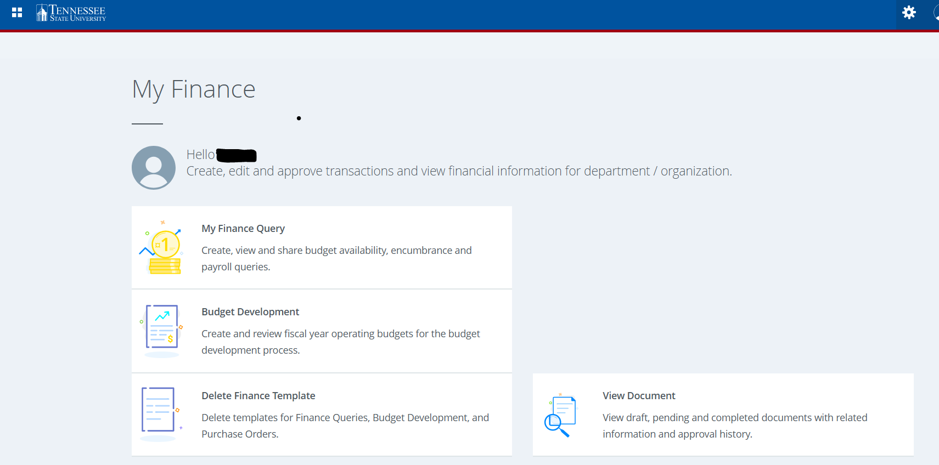
Budget Status by Account Query
Select my Finance Query

Slide 6
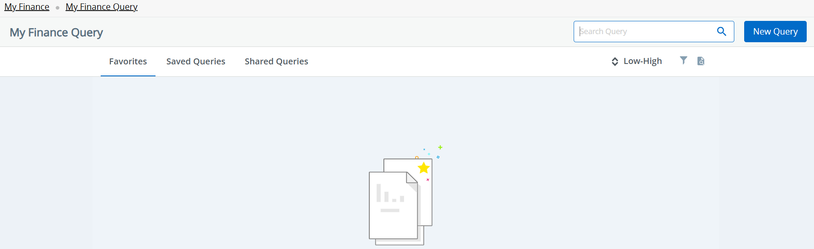
Budget Status by Account Query
Click the ‘New Query’ button in the top right corner of the screen to get started

Slide 7
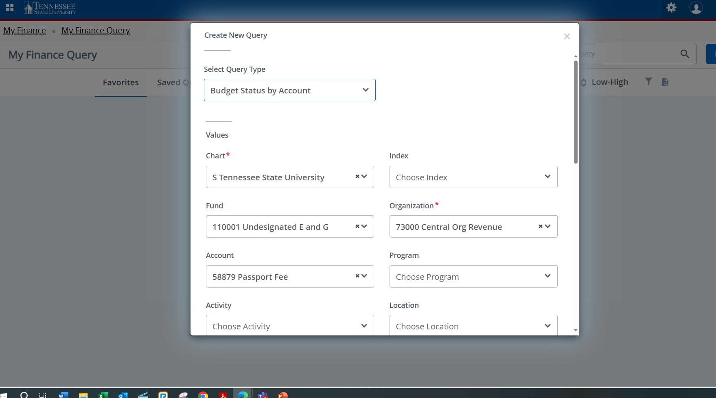
Budget Status by Account Query
Select Budget Status by Account from the drop down
Chart of Accounts should be set to “S” for University or
“F” for Foundation

Slide 8
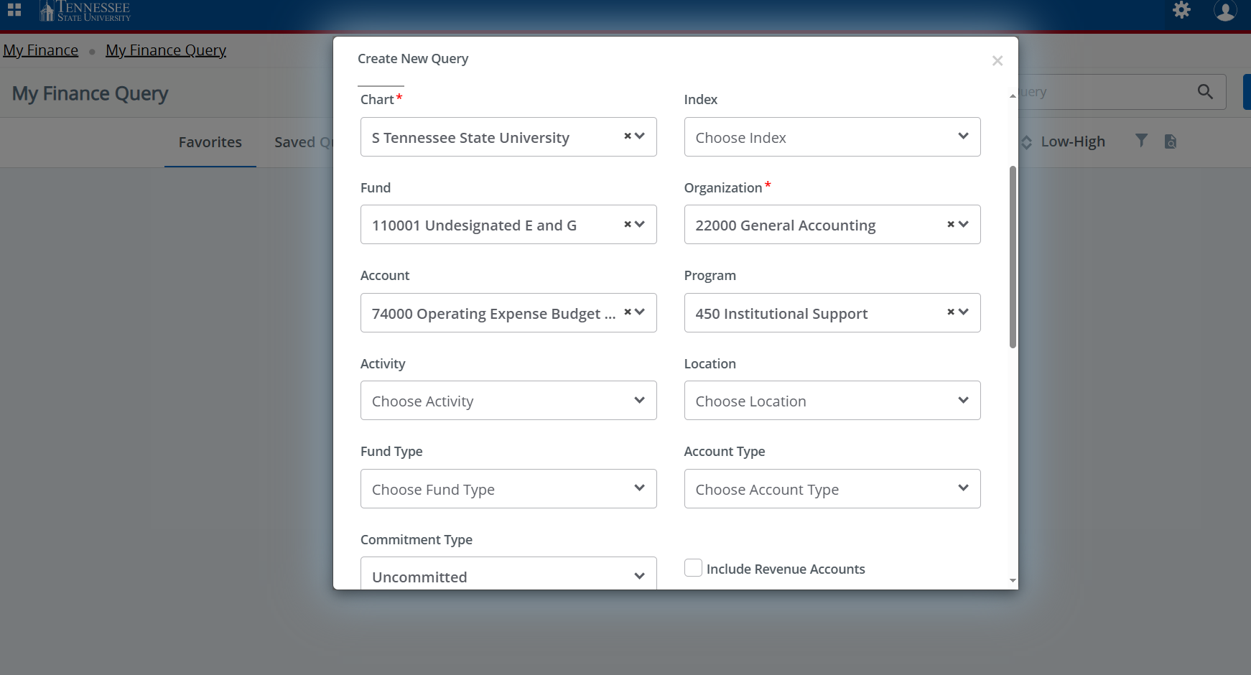
Budget Status by Account Query
❖ Important ❖
If there is anything populated in the FOAP fields, clear it out by clicking the “x” in the Index box.
❖ Enter the 5-digit Organization Number (Org Code)
A dropdown list will appear where you will select the org number.
You can also use a wildcard % to look up the org # (e.g. 22%).
❖ Once you enter and select the Org,
these fields will auto-populate as
seen on the right: (if it does not enter manually)
• Fund Number
• Program Code
❖ Important ❖
❖ Uncheck the Include Revenue Accounts
***If you need to look at revenue only then will you check it***
❖ Commitment Type select “Uncommitted”

Slide 9
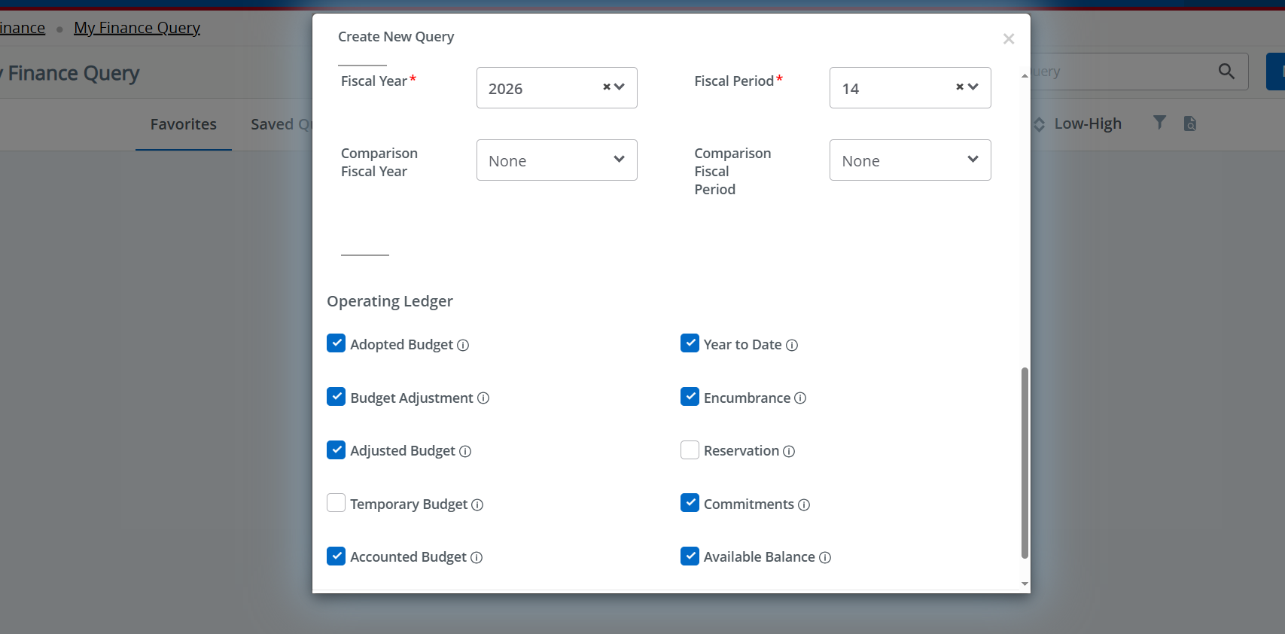
Budget Status by Account Query
Scroll down within the selection block.
For the most current information, select Fiscal Year- 2026 Fiscal Period- 14
❖ Recommended Operating Ledger Columns ❖
Adopted Budget- Budget at the beginning of the Fiscal Year (July 1)
Budget Adjustment – Additions or reductions made to the original budget
Adjusted Budget – Total Current Budget
Accounted Budget- Budget as of ‘today’
Year-to-Date- Actual transactions activity as of today
Encumbrances- Committed for future expenditures (ie PO’s and Salary) Commitments – Total budget set aside for future obligations
Available Balance – Remaining budget
After selecting operating ledger columns scroll down and select Submit

Slide 10
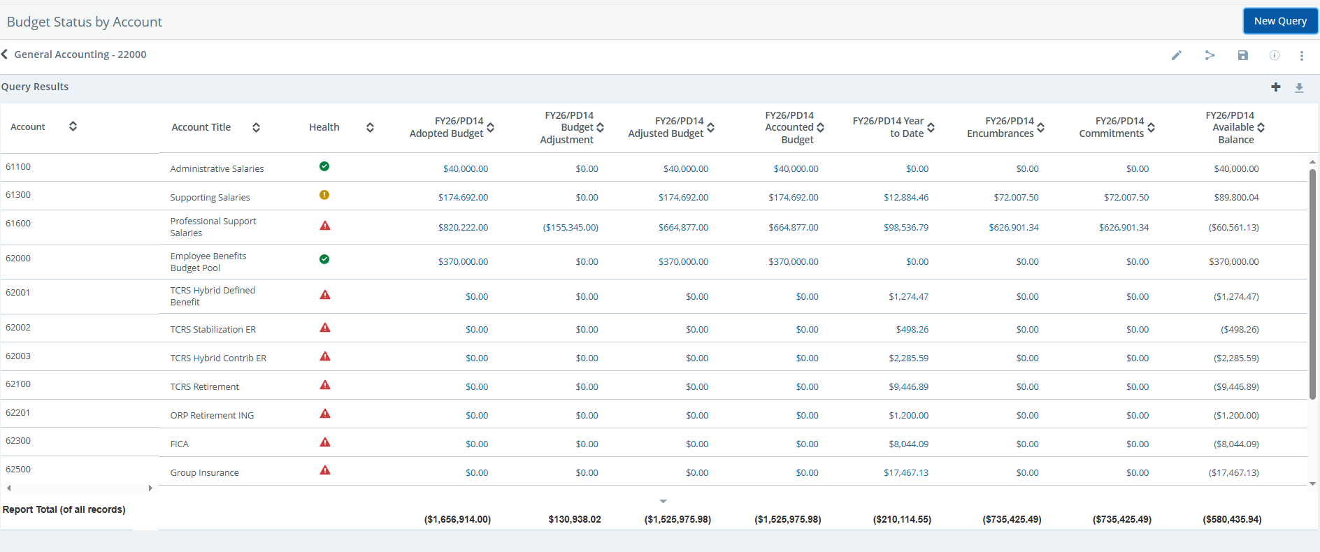
Reading the Budget Status by Account Query
Various Query Options Below
Share Query
Save Query
Edit Query
Check your ORG Title and Dates !
Download Query

Slide 11
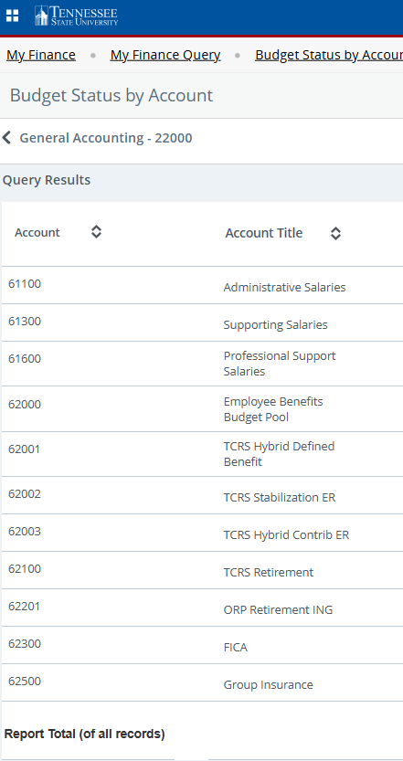
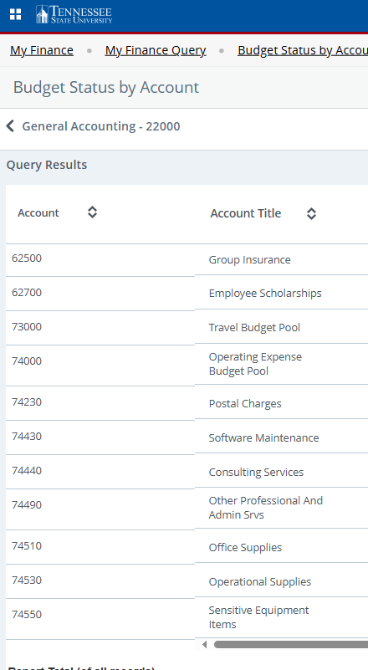
Reading the Budget Status by Account Query
The query is arranged in ascending order by Account Code. The codes fall into these categories or ‘Hierarchies’.
Account Hierarchies
5XXXX - Revenue
61XXX – Salary
62XXX – Benefits
74XXX - Operating
73XXX – Travel
The Report total for all areas is at the bottom of the query.

Slide 12
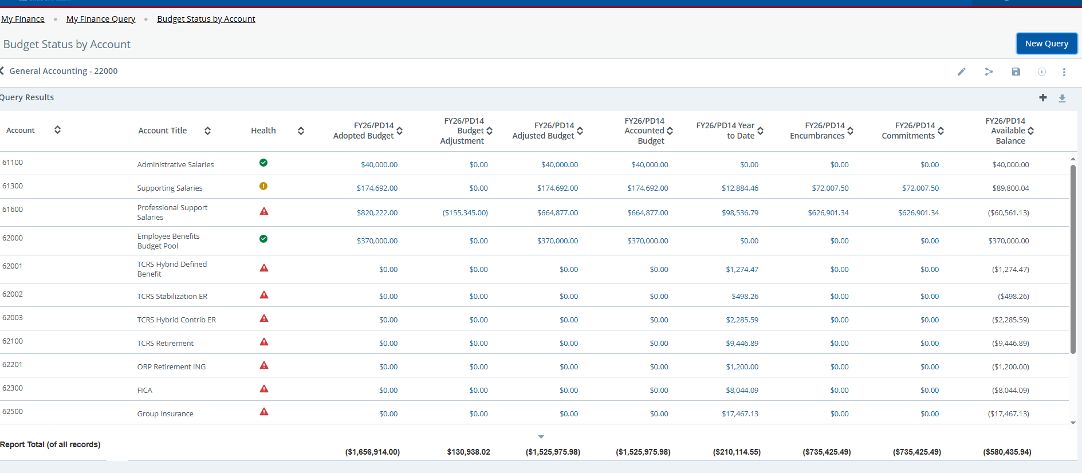
Reading the Budget Status by Account Query
Note: Amounts can be calculated both across rows and down columns
Rows: Accounted Budget – YTD – Encumbrance = Available Balance
Columns: Sum of all amount

Slide 13
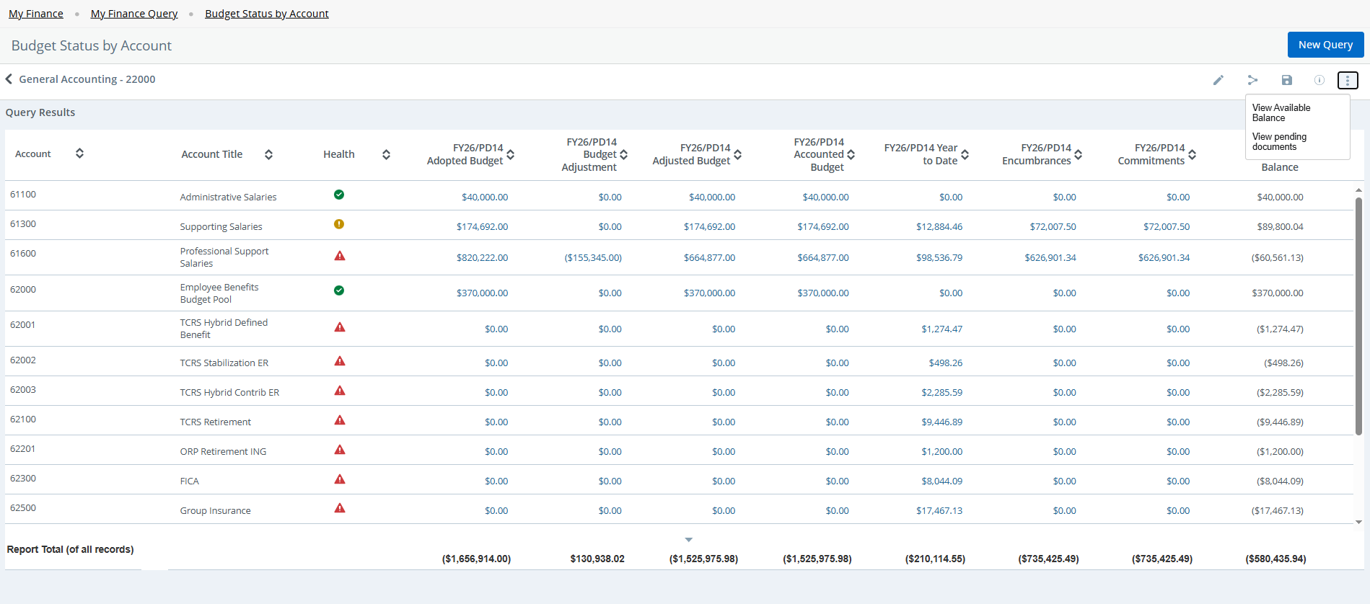
Reading the Budget Status by Account Query
Clicking on the Ellipsis Button gives you 2 options. Check Pending Documents for transactions that affect Available Balance.

Slide 14
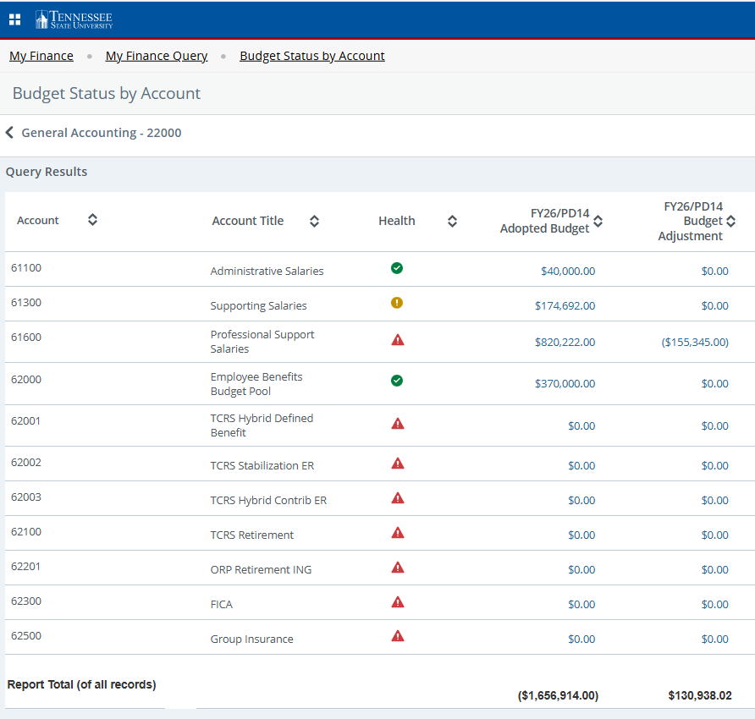
Reading the Budget Status by Account Query
Salary Account Codes (61XXX):
Often budgeted at the beginning of the Fiscal Year based on the positions that are being paid from the Org Code.
Benefits Account Codes (62XXX):
Employee Benefits are budgeted here in the pool account 62000.
You may have also noticed the icons appearing in the health column. This is a new feature to show you if you have collected or spent funds when compared to the budget amount.
Benefits is an exception due to only being budgeted in 62000, actual activity shows in the subaccounts.

Slide 15
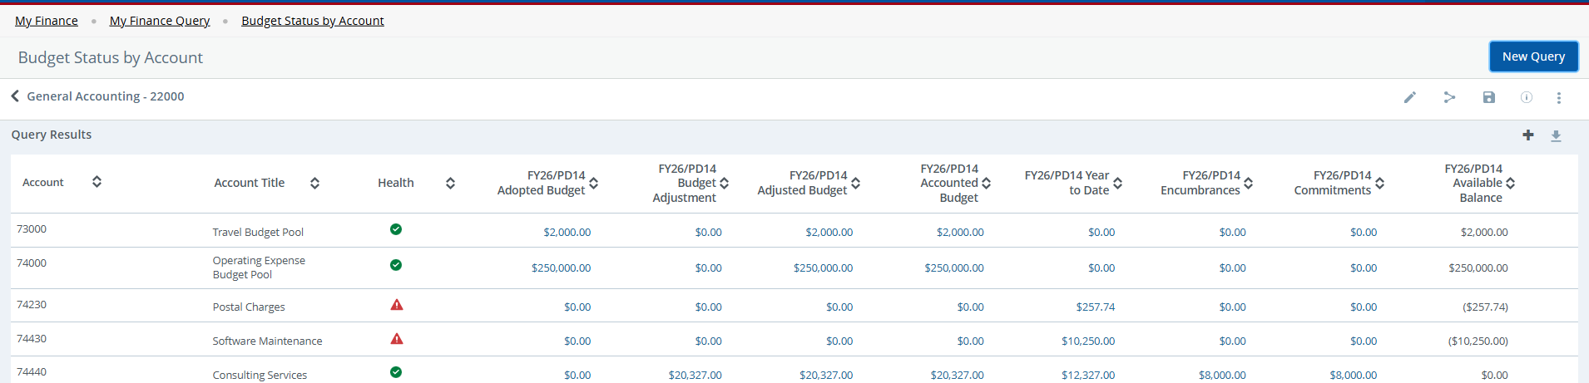
Reading the Budget Status by Account Query
The Expenditures/Operating Budget is also usually budgeted in the 73000 or 74000 code. Year-to-date charge and Encumbrances, in the 70000 series then draw off this total amount.
Pooled Accounts
Sub Accounts

Slide 16
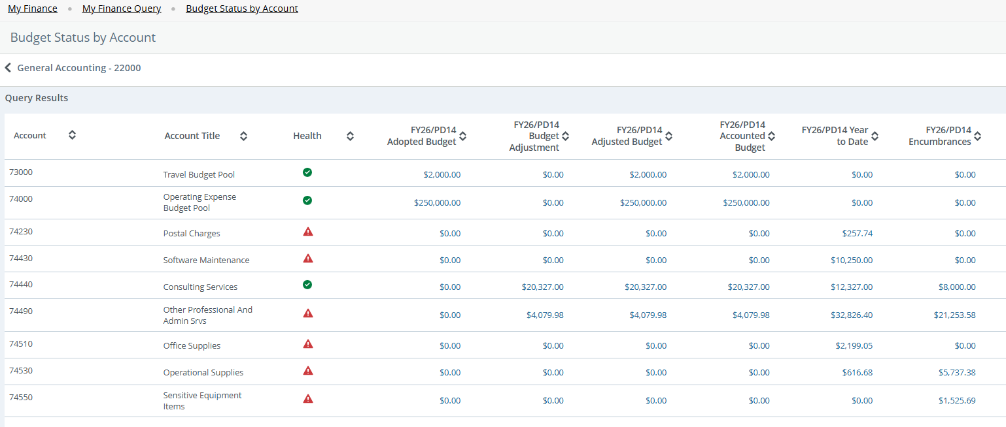
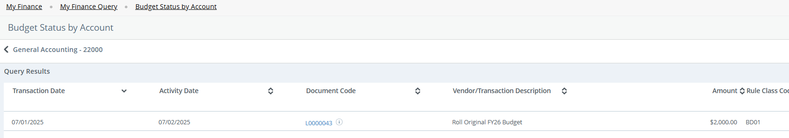
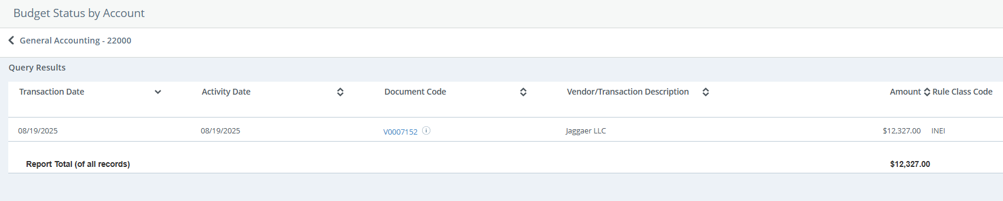
Reviewing Details in Budget Status by Account Query
NEXT
Accounts with activity will have a hyperlink, scroll mouse over amount and click link
Accounts with activity will have a hyperlink, scroll mouse over amount and click link
Date Activity Occurred
Information on Invoice
Vendor
Name
Invoice Amount

Slide 17
When to Use Budget Status by Account Query
When you need to look at the detailed account codes for information on a transaction.
When you need to research a requisition, purchase order, budget revision or other entries

Slide 18

Questions?
Contact us!
Website: www.tnstate.edu/businessoffice/budgetoffice.aspx
Ext. 6647 or 7606

