Slide 1
CPoS: ‘Do your Degrees Work?’
Sam Houston State University – Enterprise Services IT Department
Sharon Wright – ERP Analyst
Chelsie Leggett – ERP Analyst
Texas State University – Enterprise Systems
Anita Ford – Programmer Analyst

Slide 2
Disclosure
Degree Works 4.1.5 – Texas State
Degree Works 4.1.6 – Sam Houston
Our school does not have ESL courses currently

Slide 3
Agenda
Prerequisites
Banner set up – Student & Financial Aid
Whose Job is it
Pain Points
Ideas & Change Requests
SSB WebText – Custom
Testing Plan
Lessons Learned

Slide 4
Prerequisites

Slide 5
Prerequisites
General availability:
General 8.7.3
Financial Aid 8.24
Student 8.8
Accounts Receivable 8.4.5
Degree Works integration:
Student Overall 9.3
DB upgrade 9.1
Degree Works 4.1.5
Depending on the DGW release depends on which WhatIfAPI user will need keys
4.1.5 – RSAUDIT & RSWHATIF keys
4.1.6 – RSWHATIF key

Slide 6
Banner set up

Slide 7
Student Banner Set up
GORRSQL – changing the delivered sample SQL code
CPOS_ELS_RULE
CPOS_REMEDIAL_RULE
CPOS_AID_RULE
SFACPSC
DW API
Settings per institution
Use Term as Catalog Year
Use Term Code
Use Academic Year
Terms
CPOS is running for
SOAREST
DW API

Slide 8
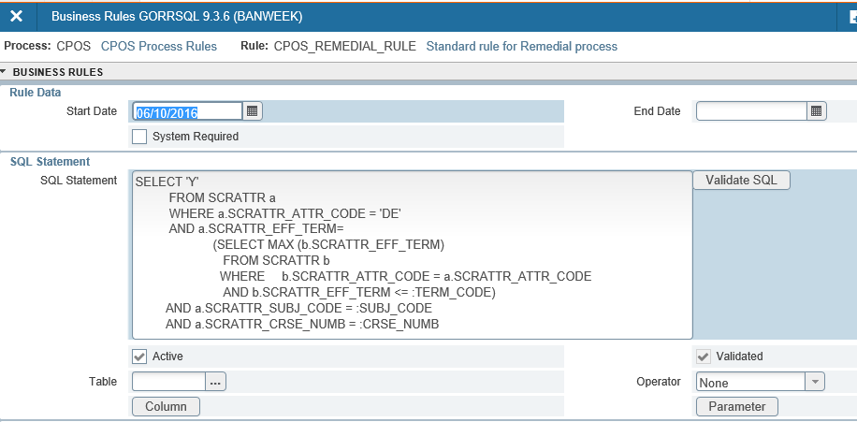
Student Banner Set up Examples
GORRSQL
SOAREST

Slide 9
Financial Aid Banner Set up
RTVENRR
RORENRR
SFACPSC
Override Rules
Repeat exclusion tab
ROAINST
RORMPRM
RFRENRR

Slide 10
SFACPSC

Slide 11
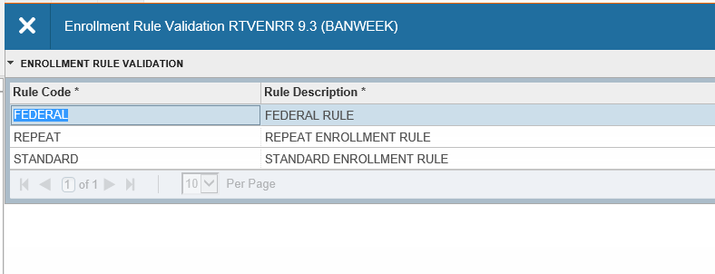
RTVENRR
Created a new enrollment rule code to use for CPoS processing ‘FEDERAL’

Slide 12
RORENRR
What was configured for the FEDERAL RULE
Repeats allowed: 1 (meaning that the student is allowed to repeat a course only 1 time after passing and still be eligible for federal aid)

Slide 13
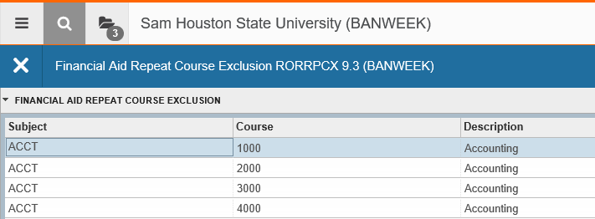
RORRPCX
Switching settings over to FEDERAL this form will no longer be looked at for Exclusion Rules.

Slide 14
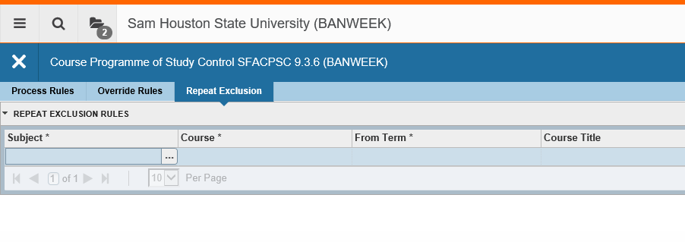
SFACPSC
**The override rules on SFACPSC are for all students
(Override Rules tab)

Slide 15
ROAINST
**Enrollment Rules – These will need to be checked if you are not running this process nightly.

Slide 16
RORMPRM
Delivered values will not use CPOS functionality
Data – define term code to begin using
Source Indicator – Local

Slide 17
RFRENRR
These were updated to FEDERAL
As long as you have not disbursed any funds for that period, switching is okay. If you have disbursed any of the funds then there will be issues if it’s changed.

Slide 18
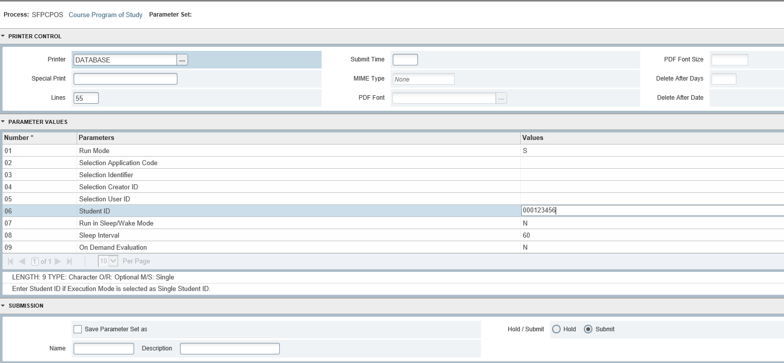
Sample Process -SFPCPOS

Slide 19
Common Output Errors
What it Says
A queried class was not found in the degree audit…
…GOAL_VALUE_BAD…
…Fallthrough…
What it Means
Warning only, usually a waitlisted course. No action needed
The major/minor, etc. code is not found in Degree Works surecode table
Needs requirement blocks in Degree Works

Slide 20
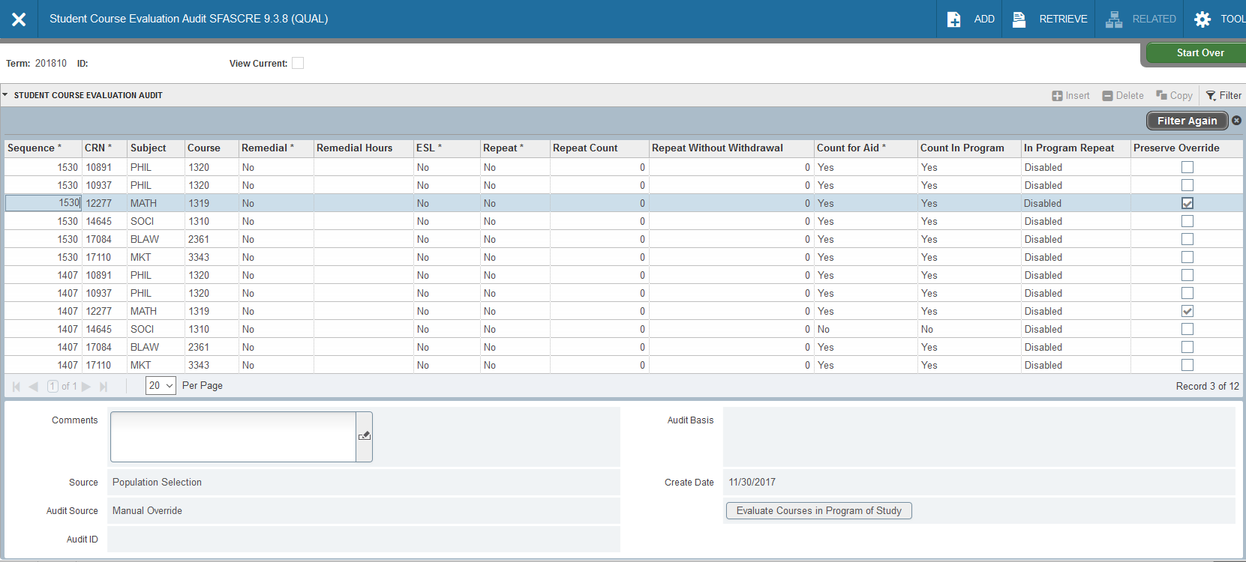
SFASCRE

Slide 21
Whose Job is it

Slide 22
Whose Job is It?
Academic Advisors
Registrar/Degree Works Scriber
Financial Aid
IT
Study Abroad
Who will set up/maintain Banner forms?
Who will run/schedule the jobs?
Who can override courses?
Who troubleshoots if the audit is “wrong?”
Who communicates to students?

Slide 23
Pain Points

Slide 24
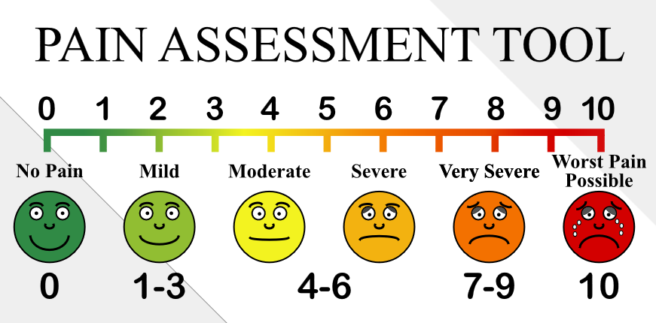
Pain Points From Degree Works Team
Had to scribe programs previously not managed through DW
“Degree Works is highly customizable, CPOS is not”
Undoing DW data mapping modifications
Electives calculation (do your blocks add up?)
Best fit algorithm issue (in-progress vs. completed courses)
Defect – program/college info (CR-000152398, 6/28/18, Stu 8.16)

Slide 25
Pain Points from Financial Aid
Job fails during large group processing (when registration opens or grades post)
When to adjust the COA? (impacts overawards)
Banner does not display info to the student
Viewed as the “bad guy making everyone do this”

Slide 26
Pain Points from Academic Advising
Extra work beyond their current duties
Locked override carries over to new major
Unlocked override gets wiped out every time schedule changes, grades post, etc.
Override applies to CRN only
No way to flag course as already reviewed
Inconsistencies between colleges

Slide 27
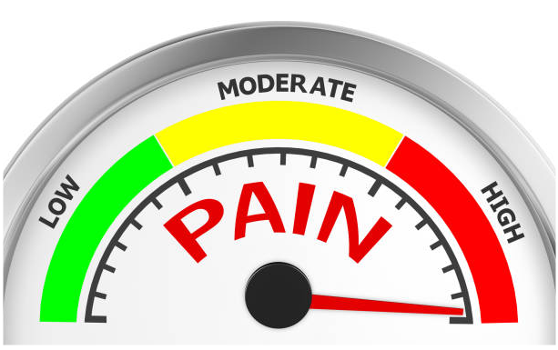
More Pain Points from Academic Advising
Updates made in DW do not trigger Banner recalculation
Only wanted to look at the students with aid impacts
Need more frequent updates during schedule changes
Timing issues with overrides while job is running
“View Current” isn’t actually current registration

Slide 28
Pain Points from Students
Delays in aid processing while issues are fixed/overridden
Final semester issues (only need 3 more hours to graduate)
Marching Band, Dance Team, etc. courses do not count for aid
Processing is not real-time

Slide 29
Ideas & Change Requests

Slide 30
Ideas and Change Requests
Ideas Searches
https://ellucian.force.com/clients/apex/ideaSearchResults?s=sfacpsc
https://ellucian.force.com/clients/apex/ideaSearchResults?s=sfpcpos
https://ellucian.force.com/clients/apex/ideaSearchResults?s=sfascre
Articles, Change Requests, etc.
Global Search for CPOS

Slide 31
SSB WebText – Custom

Slide 32
SSB WebText

Slide 33
Testing Plan

Slide 34
Testing Plan
Registrar & Fin Aid came up with the list of student IDs
Performance testing
Everyone get into a room and test
Weekly
Work through the errors
Place tickets with Ellucian
Don’t change a lot of settings
Only change 1 at a time
Check those results
Who we had testing??
Registrar, Financial Aid & IT support

Slide 35
Lessons Learned

Slide 36
Lessons Learned
Engage impacted offices (and students) early
Allow time for DW “cleanup”
Communication
Keeping up with a test plan
Details when settings are changed

Slide 37
Questions or Comments?

